Slide 1
Scaling up from ZTF to LSST “Guidelines for Community Brokers” http://ls.st/LDM-612
Required Technical Resources
Large inbound and outbound network bandwidth (a few TB/night)
Petabytes of disk capacity
Databases capable of handling billions of sources
Compute resources to handle sophisticated classification and filtering tasks in real time

Slide 2
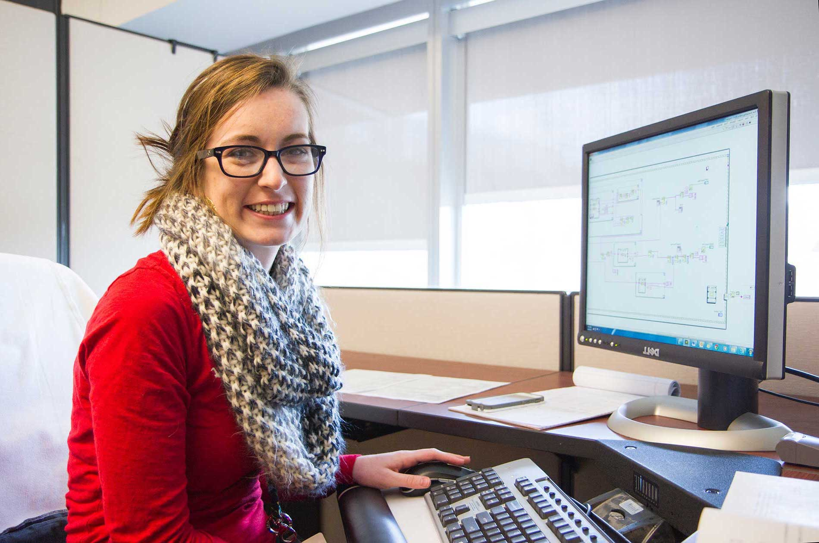
Technologies
Input:
Kafka
Compute:
Python
Docker
Spark
Users:
Apache
Django
Jupyter
Store:
MySQL
Cassandra
Kafka streams

Slide 3
Lasair Flow
head
1.5 MB/sec
ZTF = “LSST-alpha”
(in red: ZTF numbers after 6 months)
30 Mrows
30 GB
Detections
RDBMS
1.5 TB
Image cutout
files
Update objects
FITS to jpeg
Watchlists
Alerts
Streams
ML code
Objects
RDBMS
Sherlock
Crossmatch
RDBMS
Users using web and jupyter

Slide 4
Tasks and Actions
Input flow
Image processing
Object join
Lightcurves
Crossmatch

Slide 5
Input flow
Mirror-maker gets 20 Mbyte/sec
Reading from here gets 60-80% completion
Alert-stream in Docker gets 1 Mbyte/sec
https://github.com/ZwickyTransientFacility/alert_stream
Completes to 99.9%
(Even with no database insert)
Multi-threading? Multiple containers?
How to control completion?

Slide 6
Image processing
3 FITS → 1 JPEG
Runs at 100 per second
Filesystem to filesystem
How to make this parallel
Faster with blobs in database?
Assume filesystem is bottleneck

Slide 7
Object join
Each new detection
Causes stale=1 on its object
Post process
Get list of all detections that belong to stale objects, order by object, time
Process all stale objects
Query to get list takes 10 minutes!
for 10,000 stale objects
Need to speed up this query
detections
objects
Each object has collective properties:
Eg mean, min, max, lightcurve

Slide 8
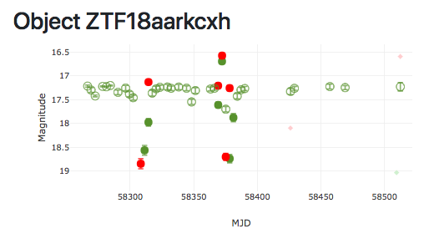
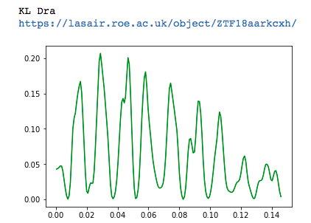
Lightcurves
User-supplied code for light-curve analysis/selection
Lomb-Scargle periodogram is simple example
For each object
Get magnitudes from database
Run code to decide
Filter out hits
How to run in parallel?

Slide 9
Crossmatch
User watchlists
Query for suitable new objects
Match against watchlists
Query lightcurve
If both good, write result into database
Send alerts
Build Slack bot
Sherlock
Read new objects
Match against catalogs
now done at QUB
Write result into database
Profile these steps
Parallel Docker containers?

